Slide 1
Osher Lifelong Learning Institute, Winter 2026
Critical Economic Topics for 2026
Bradley University
Host: Jon Haveman, Executive Director
National Economic Education Delegation

Slide 2
Course Schedule
The Economics of Public Policy Issues
  Week 1 (2/04): Economic Update, Geoffrey Woglom, Amherst College
  Week 2 (2/11): Monetary Policy, Geoffrey Woglom, Amherst College
  Week 3 (2/18): U.S. Federal Budget, Jon Haveman, Executive Director NEED
  Week 4 (2/25): International Institutions, Alan Deardorff, University of Michigan

Slide 3
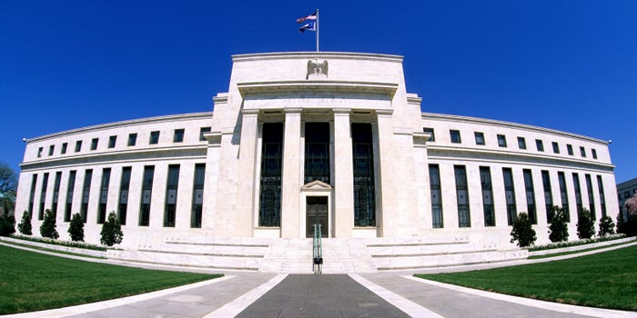
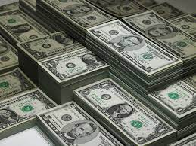
Monetary Policy & The Fed
Geoffrey Woglom
Amherst College, emeritus
National Economic Education Delegation
February 11, 2026
Notes:
Jump to 6

Slide 4
Submitting Questions
I encourage questions. Raise your digital hand or put questions in the chat
We will do a verbal Q&A once the material has been presented.
Slides will be available from the NEED website tonight https://needecon.org/delivered_presentations.php.
My Google site:
https://sites.google.com/view/macro-current-issues/home

Slide 5
Outline
Facts about the Fed; and its historical performance.
The short-run determinants of inflation and unemployment.
The Fed’s policy tools.
Central Bank Independence: what it is and why it is important.
Where does the Fed go from here: until May and after?

Slide 6
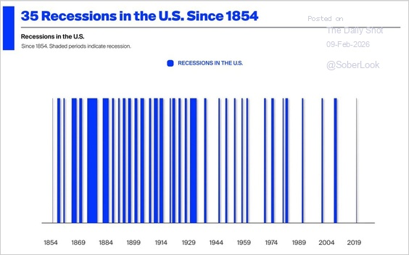
Cool Slide: On Why We Need a Central Bank
Source: https://x.com/MichaelAArouet

Slide 7
The Evolution of the Fed’s Role in the Macro Economy
Federal Reserve Act of 1913 – “furnish an elastic currency”
Employment Act of 1946
  “Full employment” is a Executive Government Responsibility.
  Council of Economic Advisors.
  Economic Report of the President.
Humphrey Hawkins Act 1978 & the Fed’s “Dual” mandate
  Full employment
  Price stability
Division of Labor between Monetary and Fiscal Policies.

Slide 8
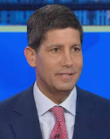
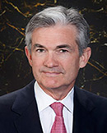
Stabilizer in Chief: the Fed
The Fed’s Dual Mandate:
  “Stable prices” which means 2% rate of inflation in the Personal Consumption Price Index (which corresponds to about 2.3% inflation in the more well-known CPI).
  “Maximum employment” which means the highest level of employment (lowest unemployment rate) consistent with mandate 1.
Monetary policy is made by the Federal Open Market Committee (FOMC), comprised of the 7 Fed Governors and 5 of the 12 Presidents of the Regional Federal Reserve Banks on a rotating basis.
The FOMC has scheduled meetings 8 times a year, but can hold unscheduled meetings at a moments notice (e.g., March of 2020)
Jerome Powell
February 2018
Kevin Warsh
May 2026 (?)
Notes:
Define inflation as the rate of increase in the average level of prices not gasoline price inflation. Exceptions Deep Recesssions. ARP we will talk about later.

Slide 9
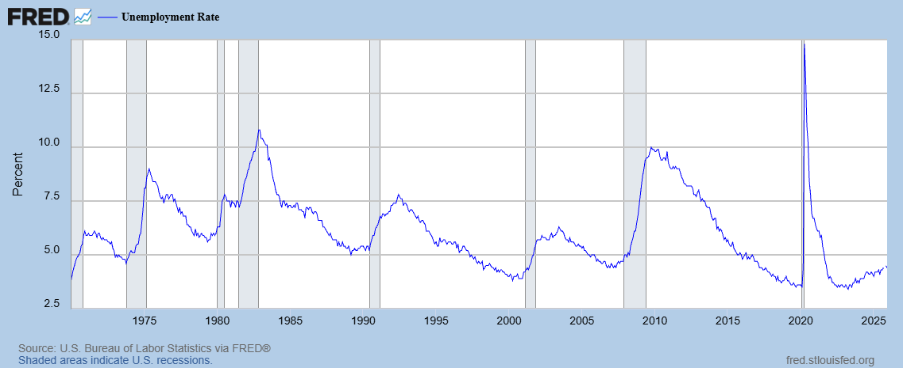
Track Record on Unemployment
Terrible 70s
1985 up to 2008 much better

Slide 10
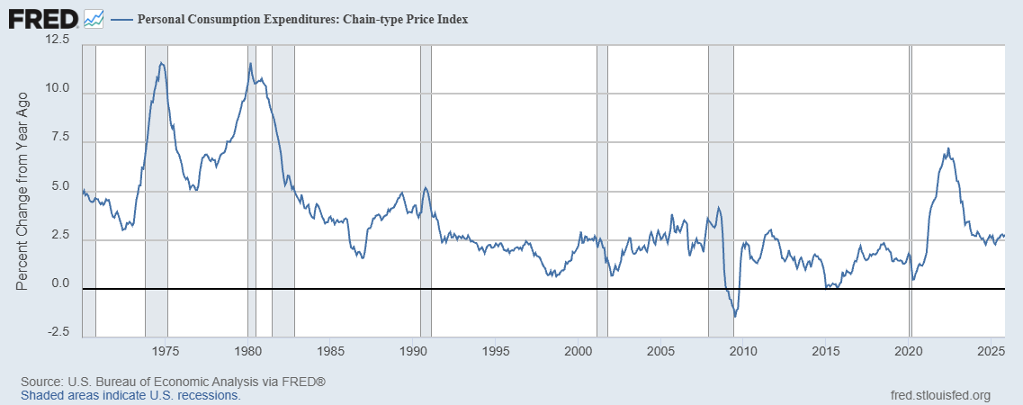
Track Record on “Price Stability”
The Great Moderation
Terrible 70s
Notes:
Shaded lines are recessions . 1970S THE Great Moderation

Slide 11
Determinants of Unemployment & Inflation
Short run:
Unemployment: The higher the level of total spending the lower the unemployment rate.
Inflation:
  “Too much Spending:” Total spending above the economy’s normal capacity (“potential output”) tends to increase inflation (Vietnam War) .
  Increase in production costs (e.g., “supply chain bottlenecks;” stagflation of the 70s)
  Expectations of high inflation can cause inflation to be high (persistence of high inflation in early 80s).
The Fed can affect 1, influence 3., but has no effect on 2.
Notes:
One sign of too much spending is a very low unemployment rate. Go back to 19 and 20 then to 21

Slide 12
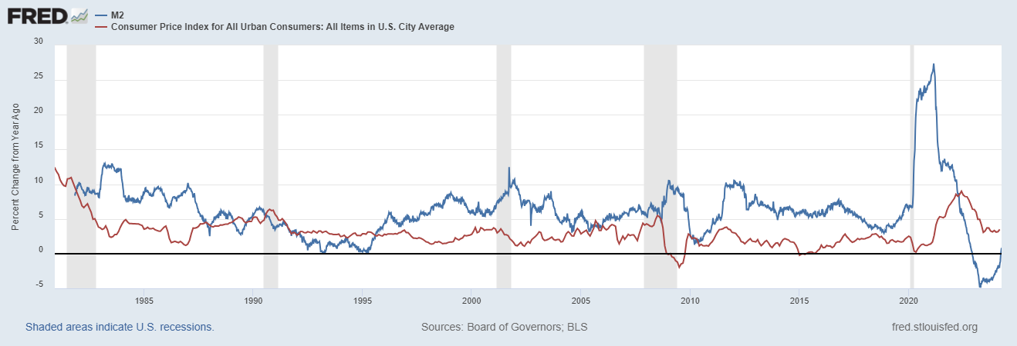
Do You See a Relationship?

Slide 13
The Fed’s Affects the Economy via Interest Rates
Higher Interest rates discourage firms from buying new plant and equipment, households from buying new homes, and tend to lower stock and housing prices (!).
Lower spending tends to raise unemployment and eventually lowers inflation.

Slide 14
Become a Central Banker in One Slide!
If you are more concerned that inflation is too high, raise interest rates to lower total spending below potential output.
If you are more concerned that unemployment is too high, lower interest rates to raise total spending.
Inflation and unemployment just right: keep rates the same.
Sounds Easy! But…

Slide 15
Two Big Complication: Lags & Dual Problems
Milton Friedman: Monetary Policy affects GDP and Inflation with Long and Variable (Unpredictable) Lags.
Raising interest rates today does nothing to spending today nor to inflation.
But over time spending slows and eventually inflation falls.
Friedman believed that lags led the Fed to “oversteer” the economy consistently.
What does the Fed do when, like the current moment, when the Fed is worried about both rising unemployment and inflation?

Slide 16
A Closer Look at Interest Rate Control
Primary Tool: the Fed targets the federal funds rate (or fed funds rate for short), the interest rate on overnight loans between banks.
The Fed adjusts bank reserves so that the federal funds rate is within a target range 25 basis points wide; e.g., 3.5-3.75%
From the bank’s perspective these loans are very close substitutes to other short-term, safe assets such as Treasury Bills.
Therefore, controlling the fed funds rate gives the Fed close control over all safe, short-term interest rates.
Notes:
Target range for the fed funds rate

Slide 17
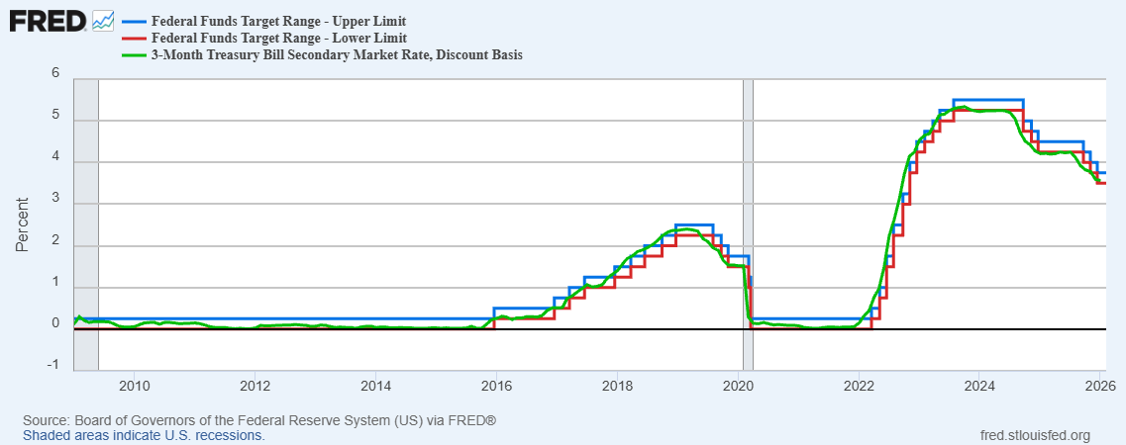
The Fed and Short-term Interest Rates
Blue is the upper-target fed funds rate.
Red is the lower-target fed funds rate
Green is the rate on 3-month Treasuries.
Notes:
Take note over the redline peeking above the others

Slide 18
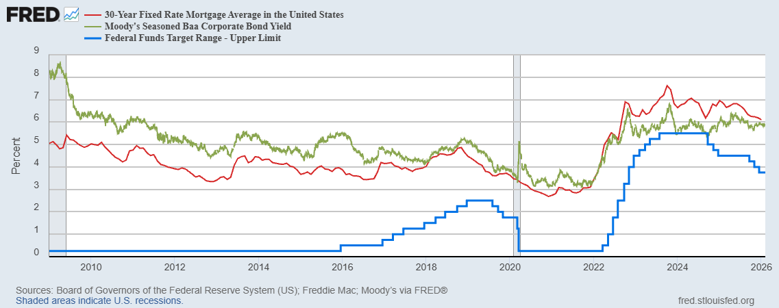
The Importance of Long-Term Interest Rates
Nobody buys a house because of the level overnight interest rates.
Notes:
Red line was 90-day cp, the TBIll line was 1 month rate

Slide 19
Long-Term Interest Rates
Unfortunately, the current fed funds rate has much less influence on long-term interest rates.
Instead, long-term interest rates depend on two factors
  The average of expected, future short-term rates over the life of the long-term bond. Friday, US Treasuries: 1-Yr 3.36; 6-mo 3.53. Why?
  “Risk” premia that reflect the possibility of unexpected changes in interest rates and the possibility of default.
The Secondary Tools are aimed at affecting these factors.
Notes:
Red line was 90-day cp, the TBIll line was 1 month rate

Slide 20
Two Secondary Tools to Affect Interest Rates
Forward Guidance: Communicating the Fed’s intentions for the future path of short-term interest rates.
Long-term Asset Purchases better known as quantitative easing or QE.
Both of these tools also affect interest rates, and thereby aggregate demand. But their effect is on interest rates for longer-term and riskier assets.
Notes:
Forward guidance occurs not just with the FOMC policy statments

Slide 21
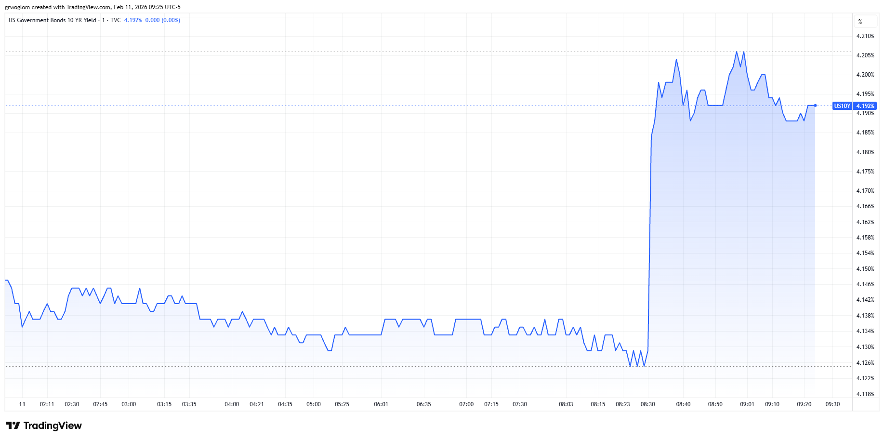
The Importance of Expectations of Future Fed Actions

Slide 22
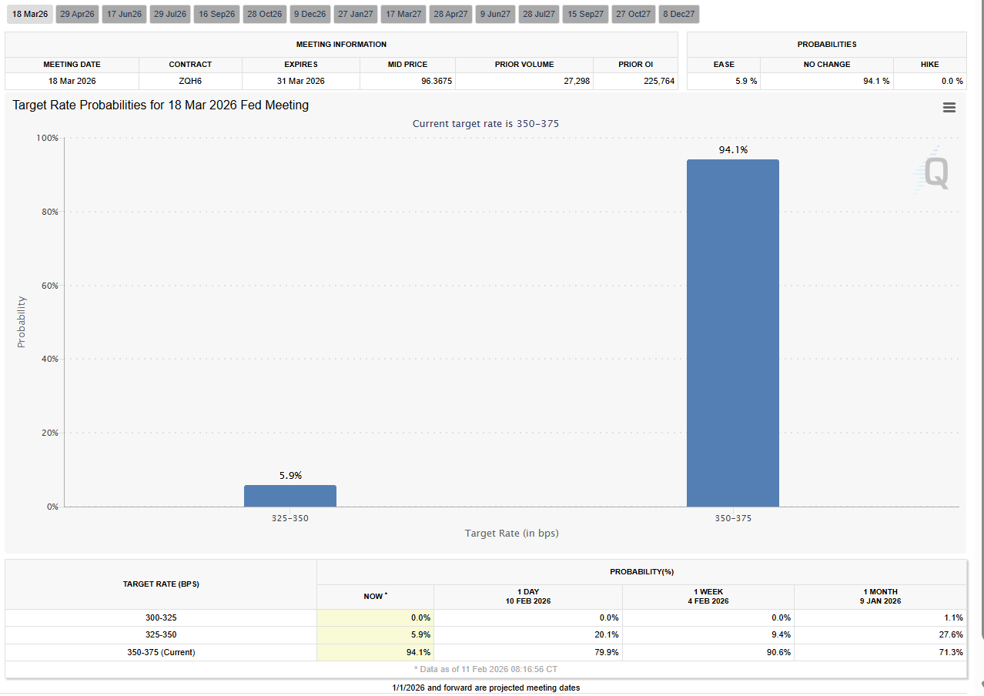
Predicting Future Fed Actions
https://sites.google.com/view/macro-current-issues/monetary-policy

Slide 23
QE And Long-term, Risky Rates
Financial investors require a higher interest rate on risky bonds, than on safe short-term Treasuries.
The lower the supply of risky bonds, the lower the required risk premia needed to get enough private investors to buy them.
QE lowers the supply of long-term bonds held by private investors and thereby lowers the required risk premia and the interest rate on these bonds.

Slide 24
QE Had Been a Big Deal
QE2
Source: Federal Reserve Board
Notes:
25% of marketable Federal Debt; 20 percent of household mortgages. Total Fed assets increase by over 1.2 tr in 9 weeks;
Then by over 2.6 tr second time.

Slide 25
A Policy Strategy: Stabilize Expectations of Inflation
Monetary Policy is much easier if the people believe that the Fed will achieve its inflation target.
Ben Bernanke (2007):
”…if inflation expectations respond less than previously to variations in economic activity, then inflation itself will become relatively more insensitive to the level of activity…”
In central bank jargon, stable expectations are “well anchored.”

Slide 26
Anchoring Requires Credibility
Credibility, the public believes that the Fed will achieve its goals.
Requirements for Credibility
  Transparency (Communication)
  Accountability (Performance) BOE Letter?
  Political Independence
Notes:
Communication releases; accountability, Congressional Testimony and 5 year full release. Political independence 14 year terms, but fragile.

Slide 27
Theoretical Case for Independent and Conservative Central Banks
Keneth Rogoff’s Conservative Central Banker paper (1985):
“Society can sometimes make itself better off by appointing a central banker who does not share the social objective function, but instead places "too large" a weight on inflation-rate stabilization relative to employment stabilization.”
Independent “conservative” central bank leads to “well-anchored” and lower inflationary expectations.

Slide 28
Paul Volcker: Rogoff’s Muse (?)
Volcker become Fed Chair

Slide 29
The Great Moderation
Volcker paid a price in the early 1980s, but the price paid dividends from 1985 through 2008.
During that period the performance of the US economy was extraordinary and even Milton Friedman gave kudos to the Alan Greenspan.
Economist in the 1980s and 90s patted themselves on the back for identifying the importance of central bank independence for anchoring inflationary expectations leading to the Great Moderation
Notes:
Go back to 16

Slide 30
Evidence: The Low-Inflation Free Lunch
Fig. 2b Variability of Real GNP
Alesina, A., and L. Summers. “Central Bank Independence and Macroeconomic Performance
: Some Comparative Evidence.” Journal of Money, Credit and Banking 25, no. 2 (1993): 151–62.
https://doi.org/10.2307/2077833.

Slide 31
Practical Effects of this Research
Countries adopt strict inflation targeting: New Zealand (1989), Canada (1991), UK (1992), Australia and Sweden (1993)
Tony Blair’s first action as UK Prime Minister in 1997 is to remove Chancellor of the Exchequer from the Bank of England.
Eurozone created 2002 which places monetary policy out of the hands of nations’ central banks and into the hands of The European Central Bank (ECB).
Where is the ECB located?
Frankfurt Germany!

Slide 32
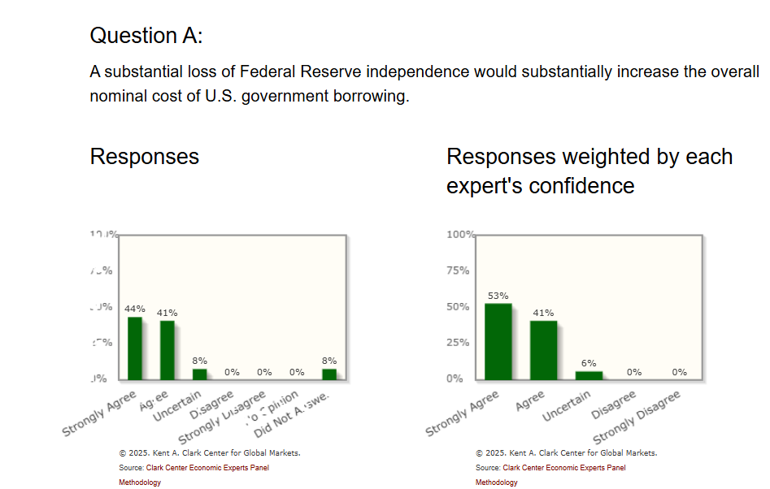
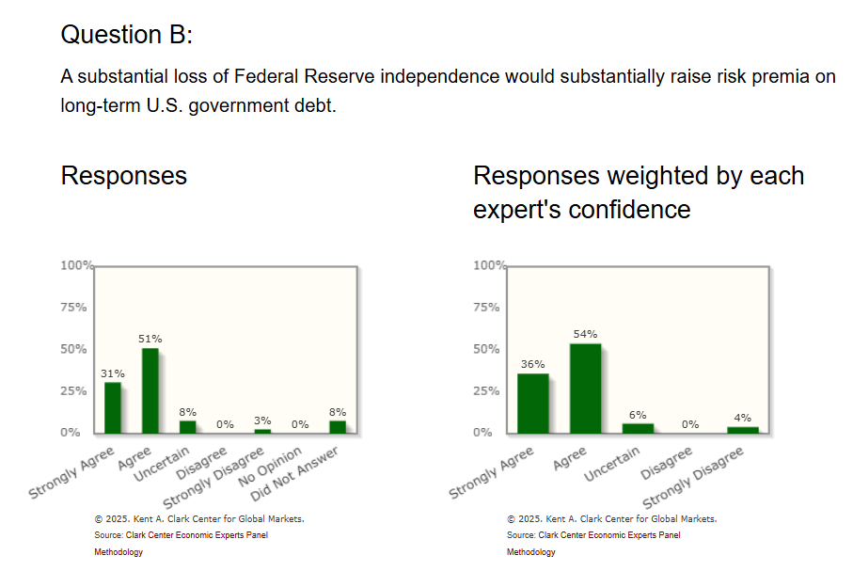
Who Says Economist Always Disagree?
https://kentclarkcenter.org/surveys/fed-independence/

Slide 33
Central Bank Independence & the Fed
Monetary Policy interest rate decisions are made by the Fed (FOMC) and cannot be reversed by other branches of government.
Federal Reserve Governors have 14-year terms.
The Chair (Jerome Powell) serves a 4-year term (which will be up next spring).
The Fed’s expenses are financed from operations; it doesn’t have to go to Congress for appropriation
The Fed is accountable to Congress and the public by:
  Congress Sets the “Dual Mandate” (but not numerical targets).
  Chair testifies to Congress.
  Policy Statement issued and Chair Press Conference after Policy meeting
  Current Policy deliberations are made available with a 6-week lag.
  All policy discussions are released with a 5-year lag.
But, as opposed to the Supreme Court, the Fed can be eliminated by a majority vote in Congress

Slide 34
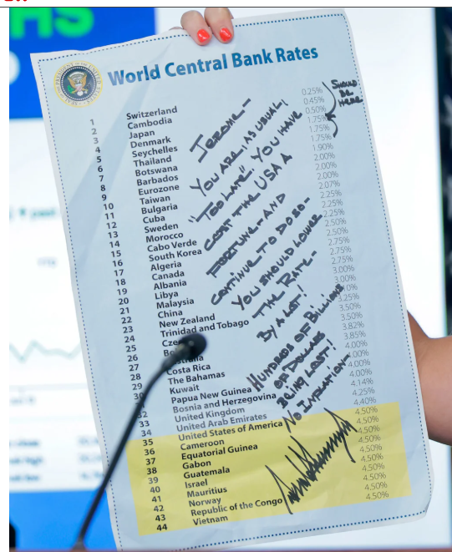
This Doesn’t Help
The irony is that the Fed would be able to lower interest rates more aggressively with no attacks.
If it appears the Fed is caving to political pressure, it will lose credibility and increase inflationary expectations.

Slide 35
An Unresolved Issue
Is Central Bank Independence Consistent with Democracy?
Things to think about: The Fed through monetary policy has the most influence on the short-run behavior of the economy. These governmental decisions are made “technocratically” and not democratically.
In the current situation should the democratic process have input in how the Fed deals with the dilemma of stagflation?

Slide 36
Questions Raised by Warsh Nomination
Will Warsh, who was an inflation “hawk,” push Trump’s agenda for lower rates?
If yes to 1., will he be able to push policy through the FOMC?
If Warsh succeeds will inflationary expectations become unanchored?
Will Powell stay on as a Governor after his term as Chair expires?
Warsh was a major critic of second round of QE in 2010. How quickly will he pursue quantitative tightening, and what will this due to long-term interest rates and the deficit?

Slide 37
My Google Site
https://sites.google.com/view/macro-current-issues/economic-update

Slide 38
Next Week: US Govt. Budget Look
2024 Budget Summary (in Trillions)
Revenue |  |  | Outlays
Income Taxes | $2.4 |  | Mandatory | $4.1
Payroll Taxes | $1.7 |  | Discretionary | $1.8
Corporate Taxes | $0.5 |  | Interest | $0.9
Other | $0.3
Total | $4.9 |  | Total | $6.8
Budget Deficit: $1.8 Trillion
Source: https://www.cbo.gov/publication/60053
Notes:
https://www.cbo.gov/publication/53627
https://www.cbo.gov/publication/53624

Slide 39
Let’s Hear from You!
Geoffrey Woglom grwoglom@amherst.edu
Contact NEED: Info@NEEDEcon.org
Support NEED: www.NEEDEcon.org/donate.php

